Slide 1
An update on the Recipe Test Workflow (RTW)
Emma Hogan and Chris Billows
ESMValTool Workshop
Tuesday, May 13, 2025

Slide 2
Overview
How are recipes currently tested for a release?
What is the Recipe Test Workflow?
How does the RTW currently work?
Demo time!
Can we use the RTW for the next release?
What would the release process be with the RTW?
How can you help?

Slide 3
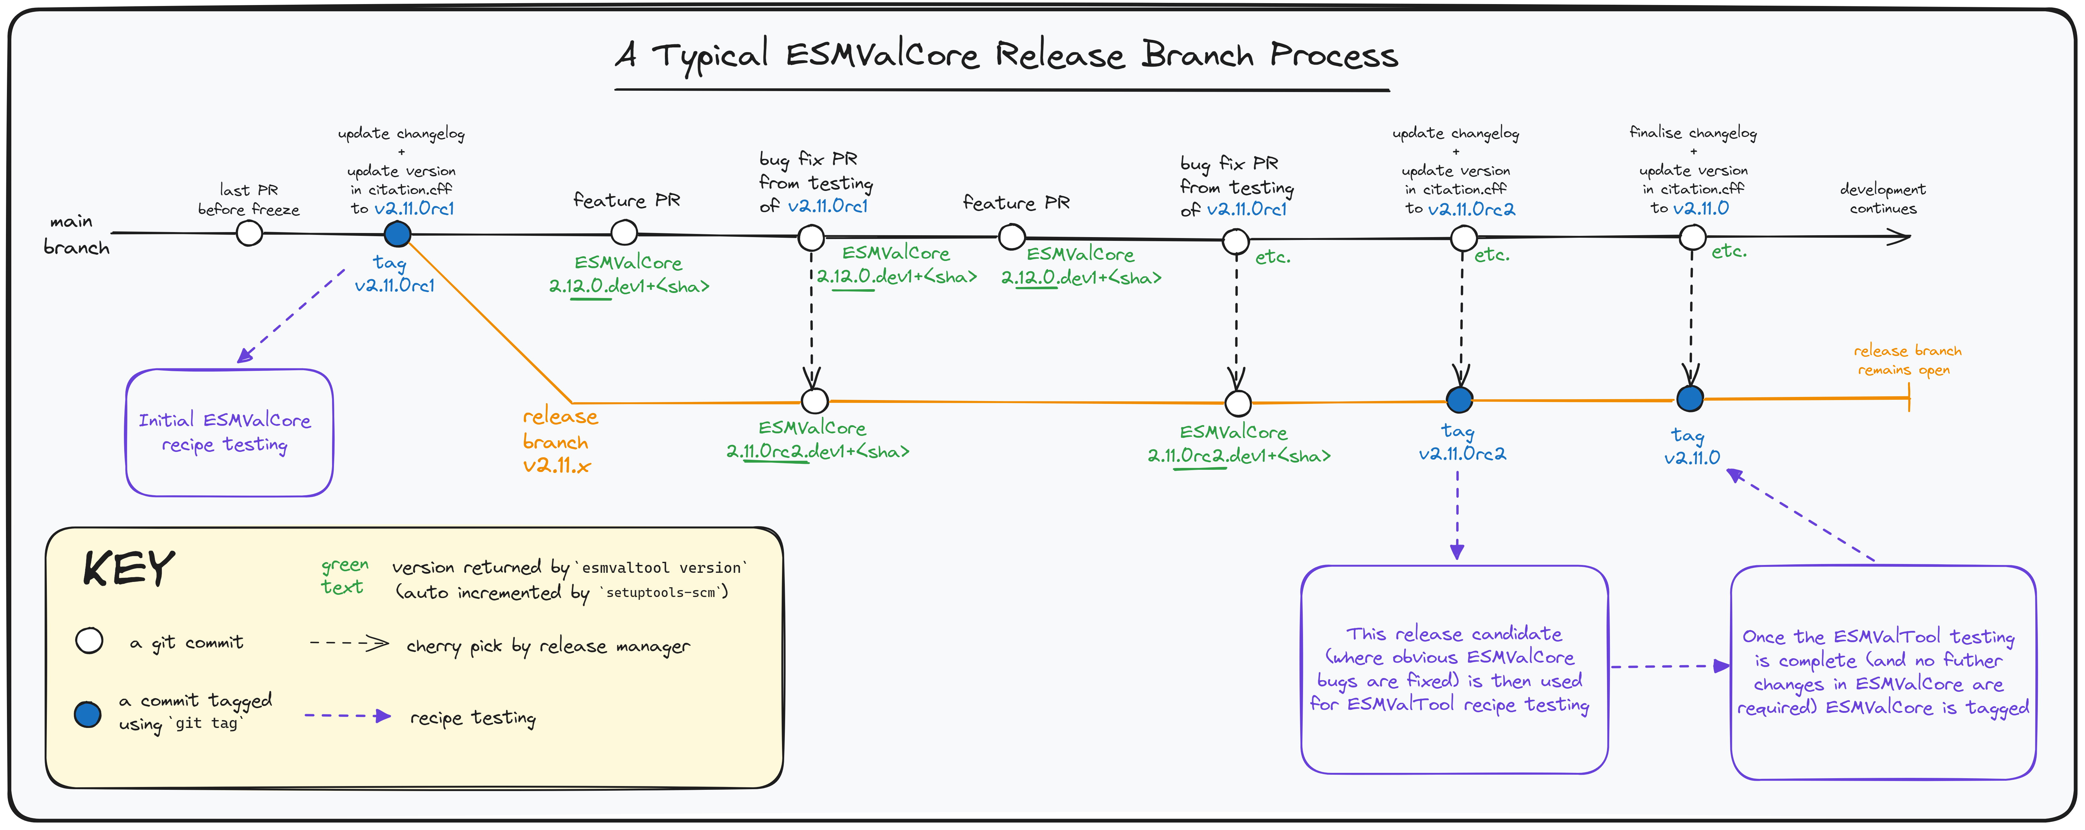
How are recipes currently tested for a release?
Notes:
+ The release manager runs all recipes on DKRZ.
+ All issues identified are reported on GitHub and subsequently fixed.

Slide 4
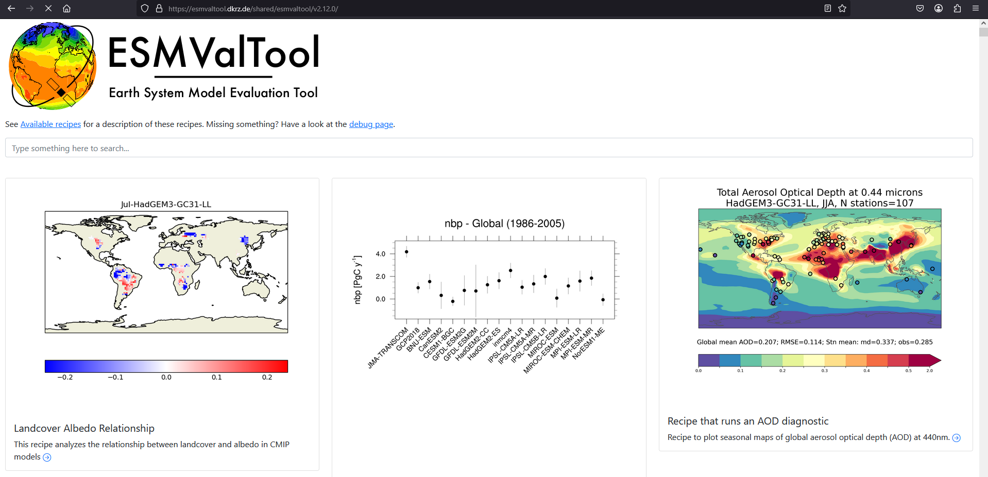
Notes:
+ The recipe outputs are shared via a web page.
+ Recipe maintainers manually check the recipe outputs and report whether the recipe outputs are as expected.
+ This may identify new issues.

Slide 5
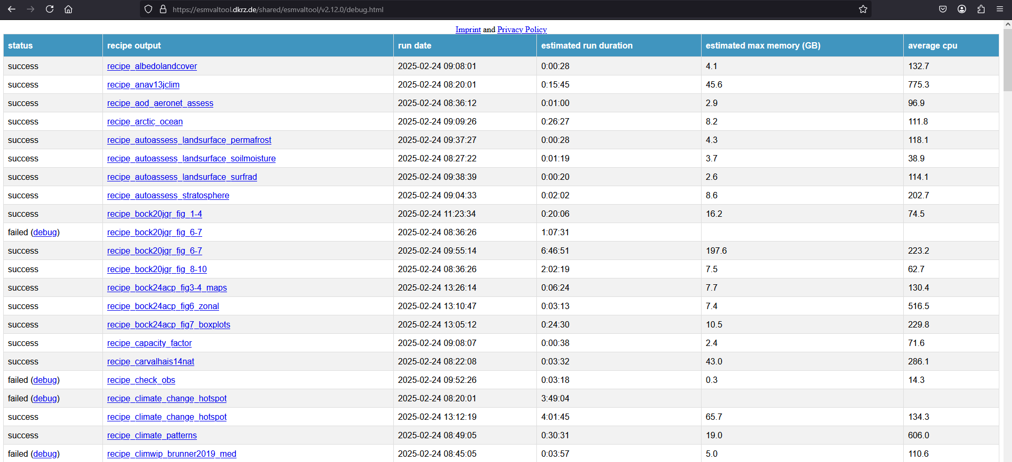

Slide 6
How are recipes currently tested for a release?
Notes:
+ ESMValCore and ESMValTool are released when all the testing is complete.

Slide 7


What is the Recipe Test Workflow?
The Recipe Test Workflow (RTW) is a workflow that is used to regularly run recipes so issues can be discovered during the development process sooner rather than later
Cylc v8 and Rose v2 are used as the workflow engine and application configuration system for the RTW, respectively
https://docs.esmvaltool.org/en/latest/utils/RTW/index.html
Notes:
+ The RTW is a Cylc workflow that enables the frequent testing of recipes between releases.​
+ This means issues will be identified sooner, making the release process less painful for the release manager.​
+ The RTW prototype was merged at the end of the last workshop in November 2024.

Slide 8
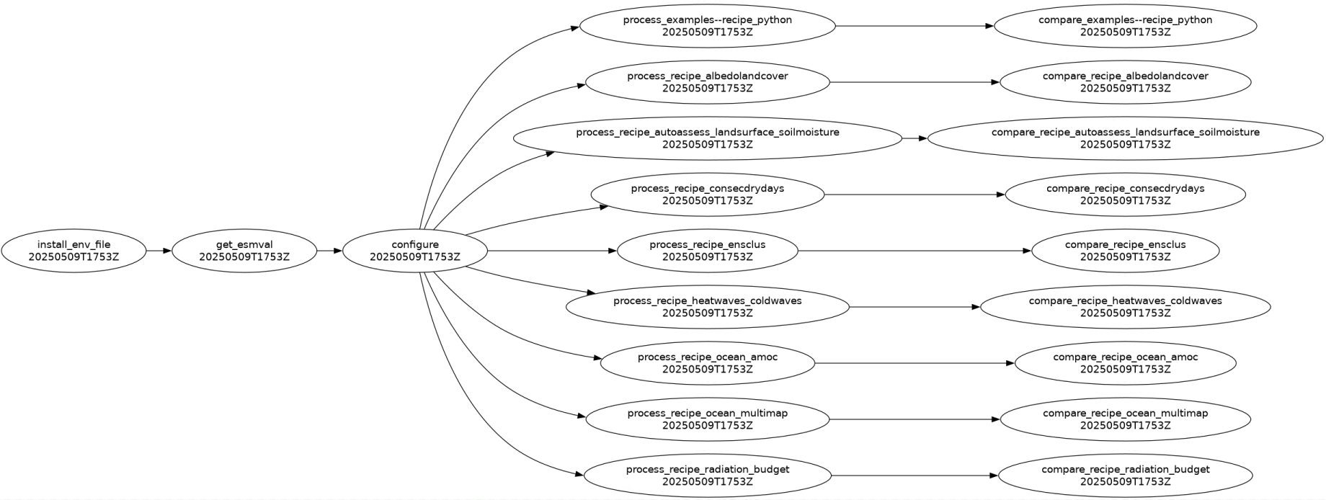
How does the RTW currently work?
Runs the requested recipes using ESMValTool
Compares the recipe outputs with KGOs
Gets the latest container image from DockerHub
Creates the ESMValTool user configuration file
https://docs.esmvaltool.org/en/latest/utils/RTW/user_guide/workflow.html
Notes:
+ These recipes are fast recipes, which means they take less than 10 minutes to complete, so they run nightly.
+ Since the prototype was merged, the RTW was updated so that it runs on DKRZ, and so different recipes are run at different sites.

Slide 9
Demo time!
(At the MO, because DKRZ can only run 5 jobs at once)

Slide 10


Can we use the RTW for the next release?
Notes:
+ Almost!
+ Currently, the RTW does not have a capability to notify anyone when there is a problem.
+ We need to update the RTW to announce when there is an issue.
+ Once this is implemented, we can use the RTW for the next release.

Slide 11

How the RTW would announce issues
Notes:
+ If a recipe failed to complete, a new GitHub issue would be opened containing all the relevant information (e.g. recipe name, traceback, any useful logs)
+ If the recipe completed but the comparison step failed, a new GitHub issue would be opened with before / after / difference plots
+ If the change is approved, the KGO would be updated
+ If the change is not approved, an appropriate fix would be introduced

Slide 12
Notes:
+ This page would no longer be needed, and recipe maintainers would only need to check their recipe outputs if there was a science-related difference, and not for every release!

Slide 13
Requirements discussion
Issues would likely need triaging to determine the cause of the failure. What would be the best way to do this?
How should GitHub issues be opened? One per recipe? One per task? One per day?
Multiple recipes might fail due to a single change to ESMValCore
Additional comments could be added by the RTW if the recipe is still failing a week later
GitHub issues would be owned by the person who ran the RTW. Would it be worth creating shared accounts for this purpose?

Slide 14
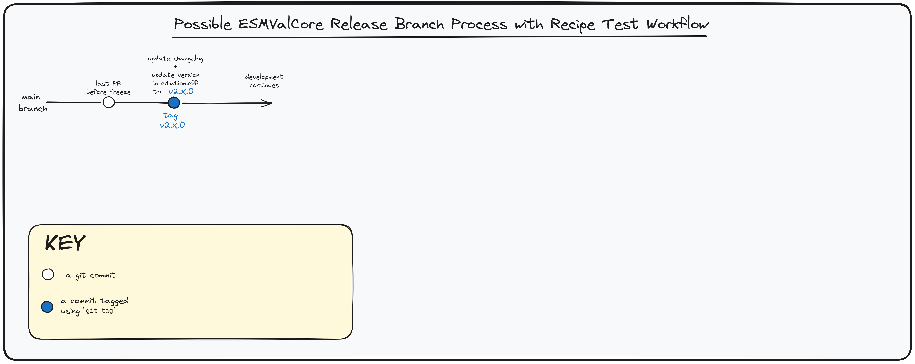
What would the release process be with the RTW?

Slide 15

How can you help?
Notes:
+ Join us in the coding sessions for the next three afternoons!

